Slide 1
TASFAA 2017 Education Is Key

Slide 2
TASFAA 2017
R2T4 for Credit Hour Programs and Modules
MTSU’s Withdrawal Process - Identification to Notification
Education Is Key

Slide 3
TASFAA 2017
Identification
Education Is Key

Slide 4
TASFAA 2017
Official Withdrawals
Reports from the Registrar
Reports from the Bursar (checking charges)
Reports from the Withdrawal Office (backdated withdrawals)
Education Is Key

Slide 5
TASFAA 2017
Unofficial Withdrawals
Banner report
Attendance adjustment report (Argos)
Education Is Key

Slide 6
TASFAA 2017
Modular Withdrawals
Modular Withdrawal Report (SQL)
Education Is Key

Slide 7
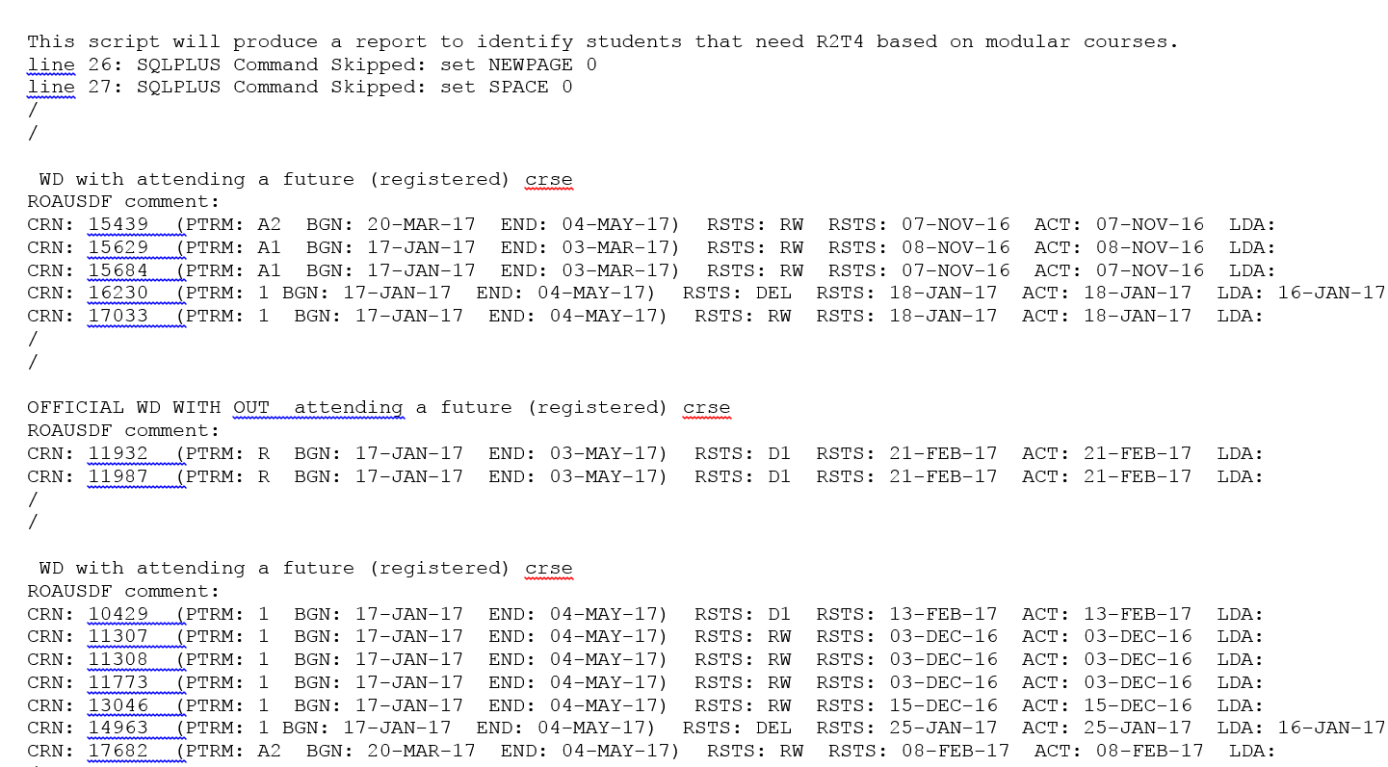
TASFAA 2017
Education Is Key

Slide 8
TASFAA 2017
Purged Students
We use a report in Argos to capture student information shortly before students are purged.
We then use that information to contact instructors and determine if the student is eligible for a post-withdrawal disbursement.
Education Is Key

Slide 9
TASFAA 2017
Purged Students – Information in Report
ID
Name
Activity Date
Attendance Confirmation
Attendance Confirmation Date
Course Registration Number
Course ID
Part-of-Term
LDA
Registration Status Code
Registration Status Date
Term
User
Transaction Date
Aid Indicator
Faculty Member’s Name
Faculty Member’s Email Address
Education Is Key

Slide 10
TASFAA 2017
Processing R2T4
Education Is Key

Slide 11
TASFAA 2017
Step 1: Has the student withdrawn?
Official Withdrawal – All courses are dropped.
Unofficial Withdrawal – Combination of official drops and/or LDAs.
Modular - Is the student enrolled in an upcoming part-of-term? Is a letter of intent needed? MTSU’s letter of intent is a Dynamic Form (NextGen) – Receiving much better response from students.
Education Is Key

Slide 12
TASFAA 2017
Step 2: Setting up the R2T4 calculation
What is the withdrawal date?
Make sure that the student hasn’t indicated that they have ceased attendance prior to the withdrawal date either verbally or in writing.
Helpful hint – Train everyone on how to document a conversation regarding a withdrawal question!
Verify start and end dates
Verify break dates
Verify charges
Have instructors reported attendance/non-attendance?
Education Is Key

Slide 13
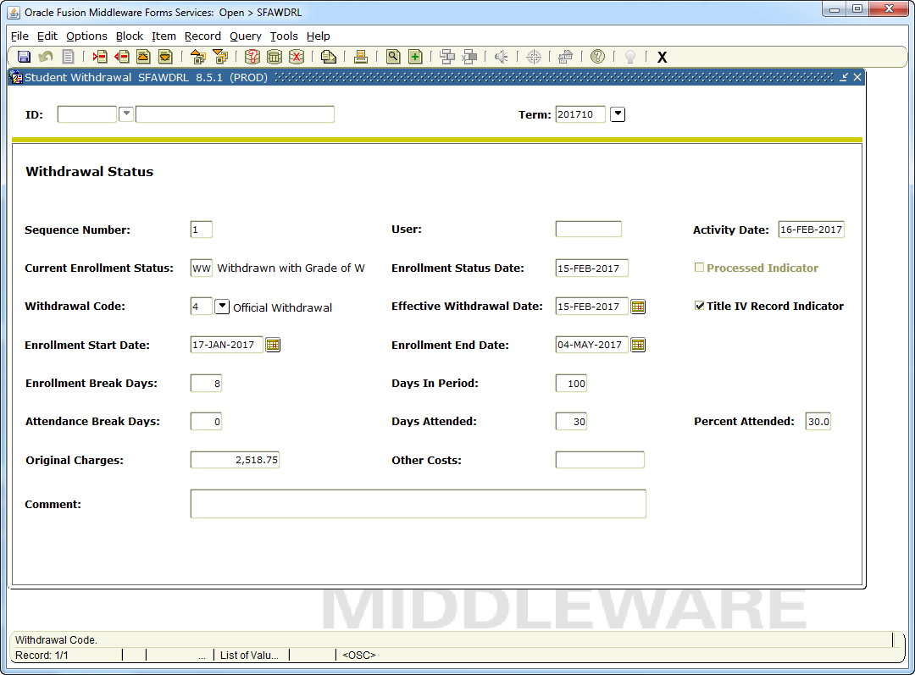
TASFAA 2017
Example - SFAWDRL
Education Is Key

Slide 14
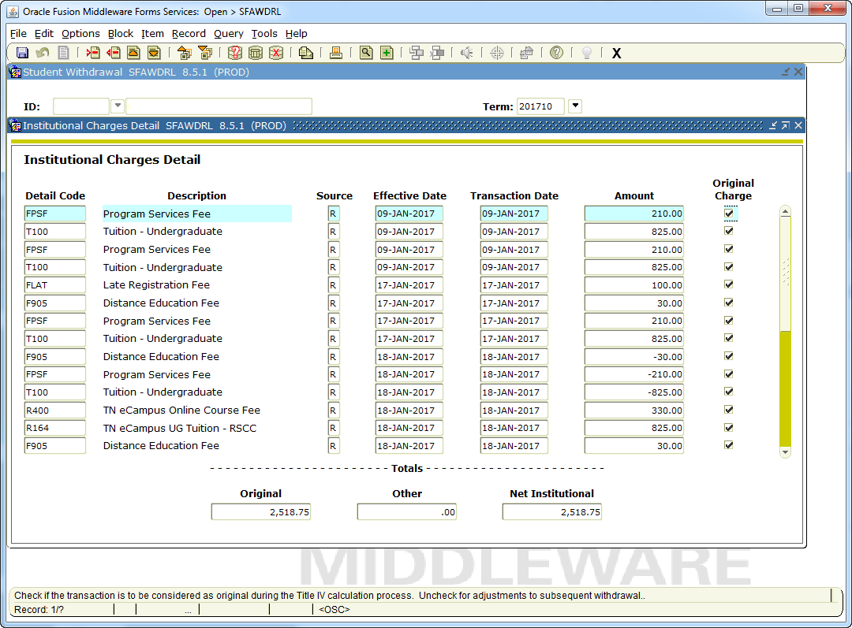
TASFAA 2017
Education Is Key

Slide 15
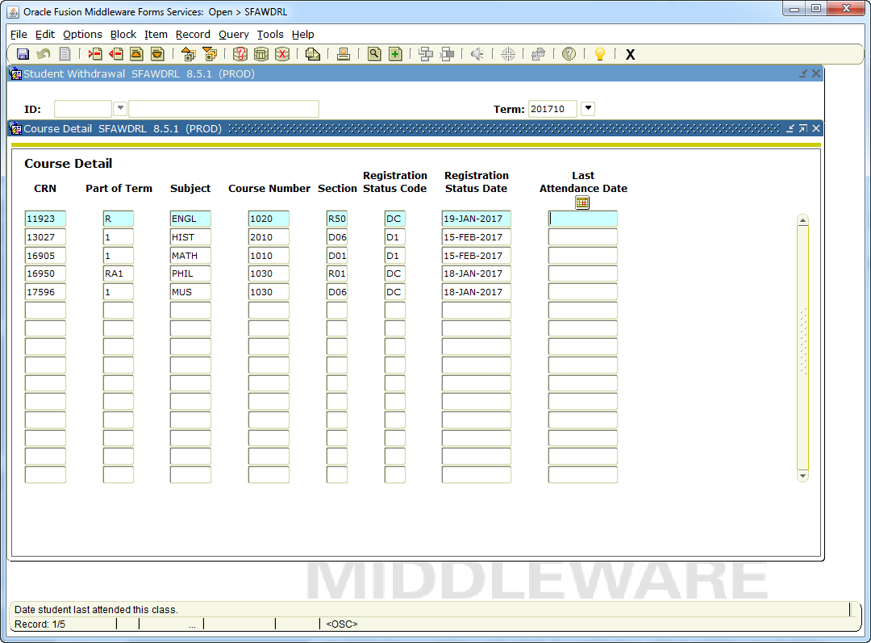
TASFAA 2017
Education Is Key

Slide 16
TASFAA 2017
Step 3: Verifying Aid Eligibility
Is the aid correct? Has the student started attendance in all courses? Does aid need to be recalculated?
Correct any overawards prior to R2T4 calcualtion
LDAs on or before census date
Prior to start of a later POT
Non-Title IV eligible courses such as Repeats, audit, etc.
Comment Code 399
*If on or before census, recalculate any state aid institutional aid, etc.
Education Is Key

Slide 17
TASFAA 2017
Step 4: R2T4 Calculation
Make sure disbursed aid is correct, and that any aid that should be counted as “aid that could have been disbursed” is included in the calculation.
At MTSU, Pell Grant is reduced automatically through census (PRD). You must decide whether or not to disburse the eligible amount before completing the calculation.
Use net amounts for Federal Direct Loans.
In some cases, a manual calculation will be required.
Education Is Key

Slide 18
TASFAA 2017
Documentation
No printers!
MTSU uses Snagit (screen capture program) to capture Banner screens and then to notate if needed.
The images are then imported into BDMS
It is very important to document the withdrawal.
Education Is Key

Slide 19
TASFAA 2017
Notification
Education Is Key

Slide 20
TASFAA 2017
Argos
MTSU’s withdrawal letters are automated via Argos
ROAUSDF is coded for the type of withdrawal, which then triggers Argos to run the report for that specific letter.
The letter is generated the next morning, emailed to the student, a copy placed into a network folder for printing and mailing, and finally imaged and indexed to BDMS.
MTSU uses AXRM to image the letters to BDMS.
Education Is Key

Slide 21
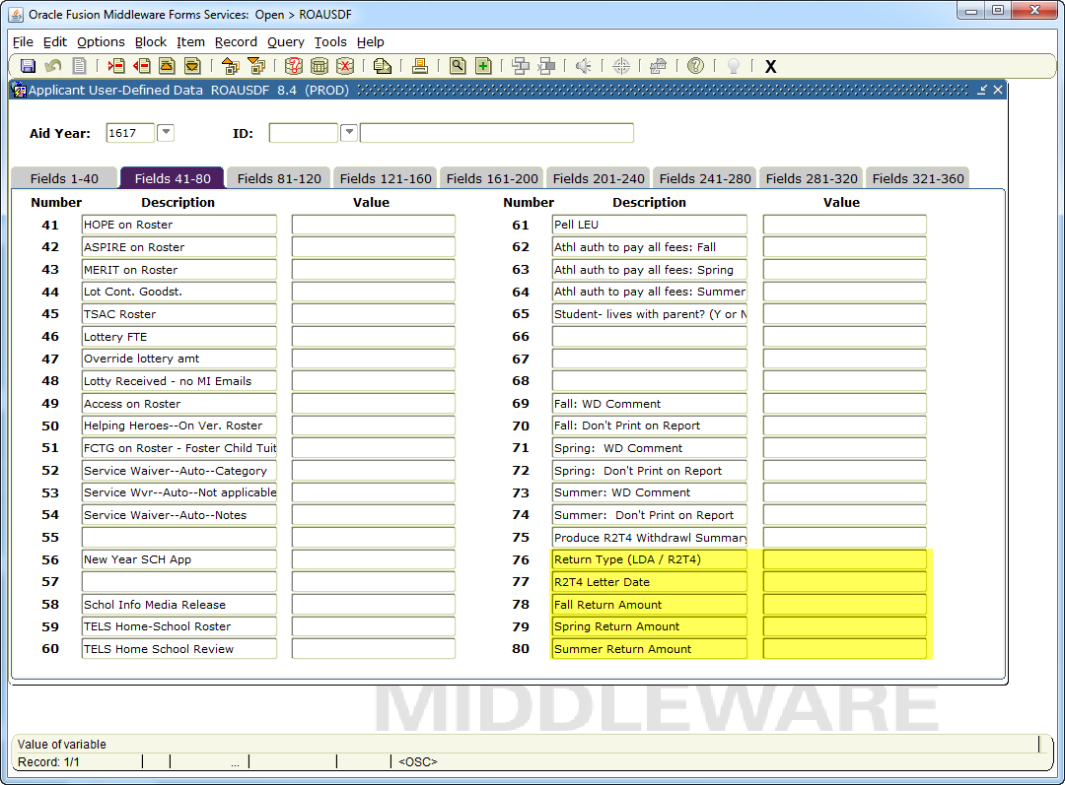
TASFAA 2017
Example - ROAUSDF
Education Is Key

Slide 22
TASFAA 2017
Withdrawal Letter Codes
Official Withdrawal – R2T44
Official Withdrawal 60% - R2T4460
Unofficial Withdrawal – R2T47
Unofficial Withdrawal 60% - R2T4760
Modular Withdrawal – R2T4A
Modular Withdrawal 60% - R2T4A60
Education Is Key

Slide 23
TASFAA 2017
End-of-Term Processes
Education Is Key

Slide 24
TASFAA 2017
Grading Policy
MTSU’s grading policy requires that instructors report LDAs for students that are assigned a grade of F.
This creates many unofficial withdrawals at the end of the term.
Education Is Key

Slide 25
TASFAA 2017
End-of-Term Reports
Argos report to identify students that have officially withdrawn with an added LDA.
Argos report to identify students that have unofficially withdrawn with an earned grade.
Education Is Key

Slide 26
TASFAA 2017
Q & A
Education Is Key

Slide 27
TASFAA 2017
Contact Info
Isaac Jones
charles.jones@mtsu.edu
615-898-5151
Leann Eaton
leann.eaton@mtsu.edu
615-898-2246
Education Is Key

